Slide 1
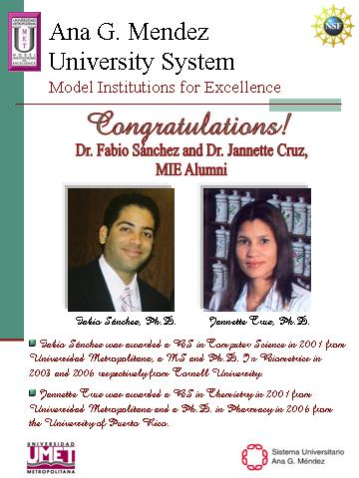
Bridge to Graduate School 2006

Slide 2
Student
Peer Reviewed
Publications

Slide 3
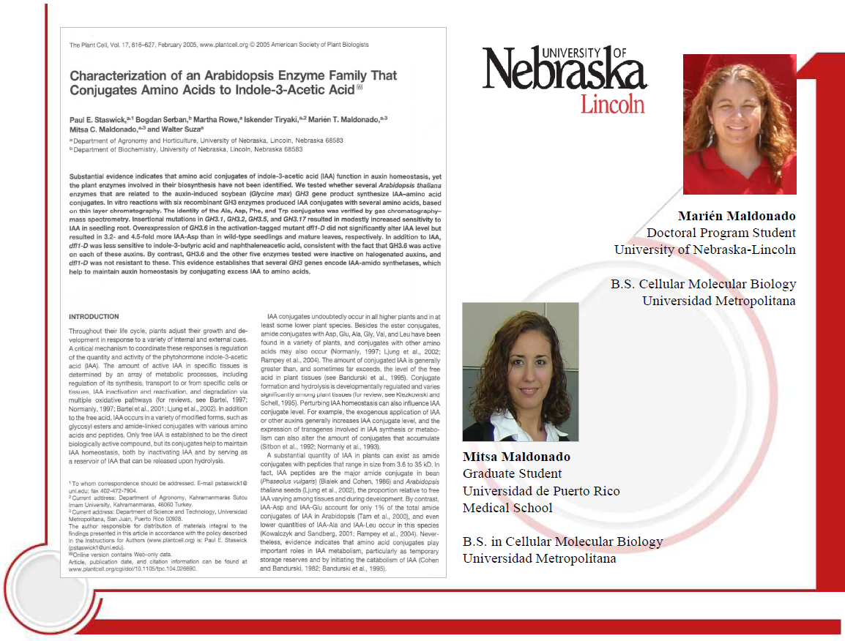

Slide 4
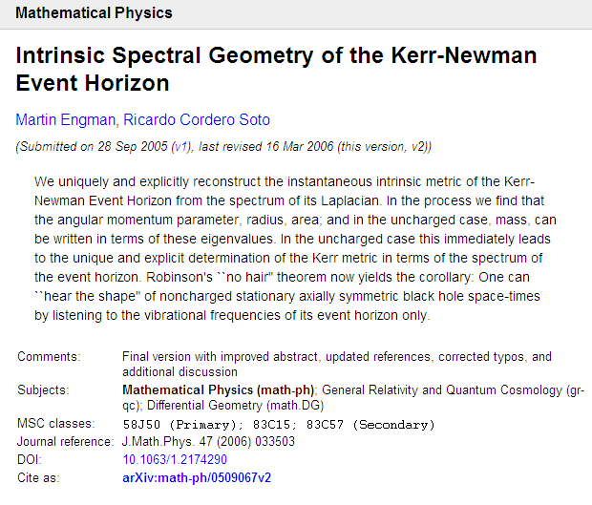

Student Peer Reviewed
Publications
Ricardo Cordero, Ph.D. (2011)
Arizona State University

Slide 5
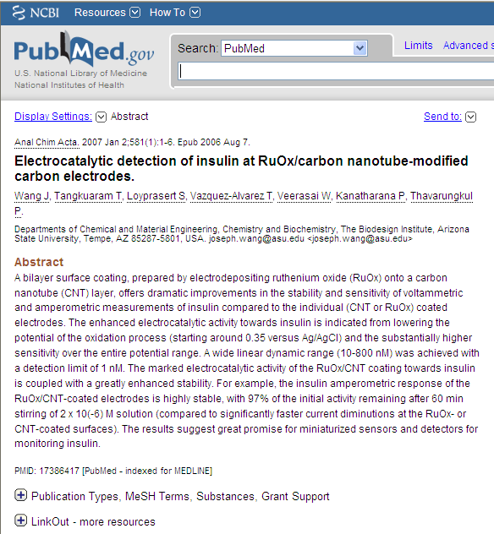
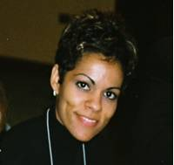
Terannie Vázquez, Ph.D. (2009),
Arizona State
University

Slide 6
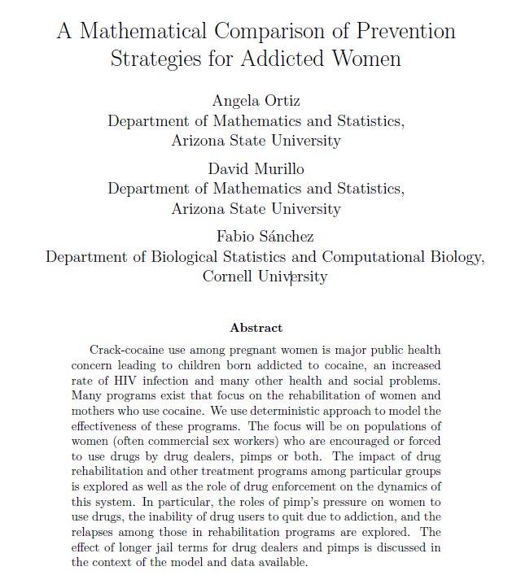
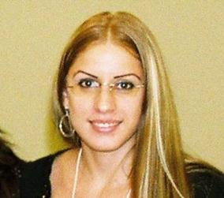
Ángela Ortiz, Ph.D. (2010)
Arizona State University

Slide 7
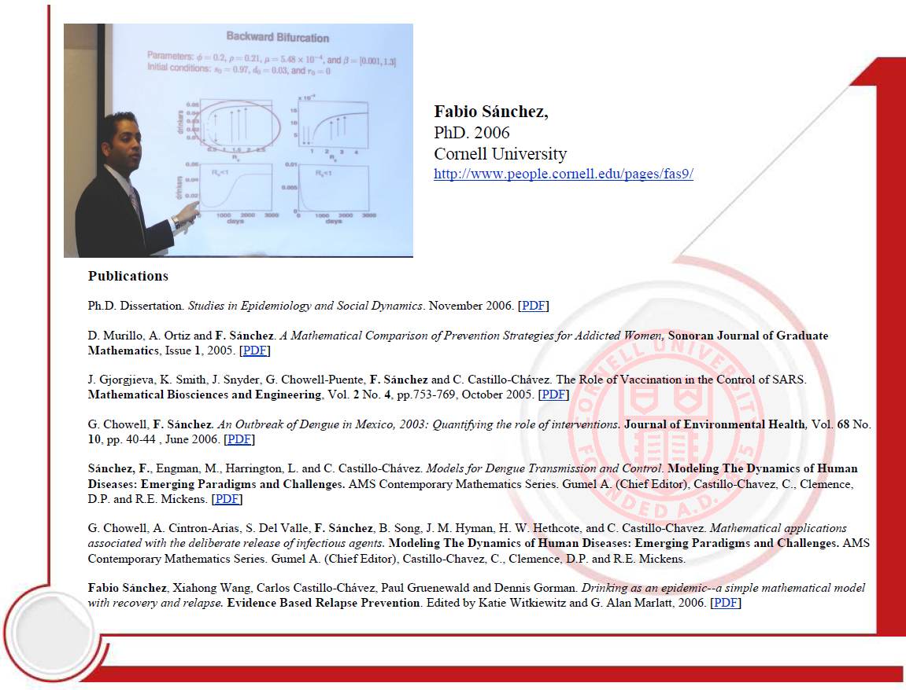

Slide 8
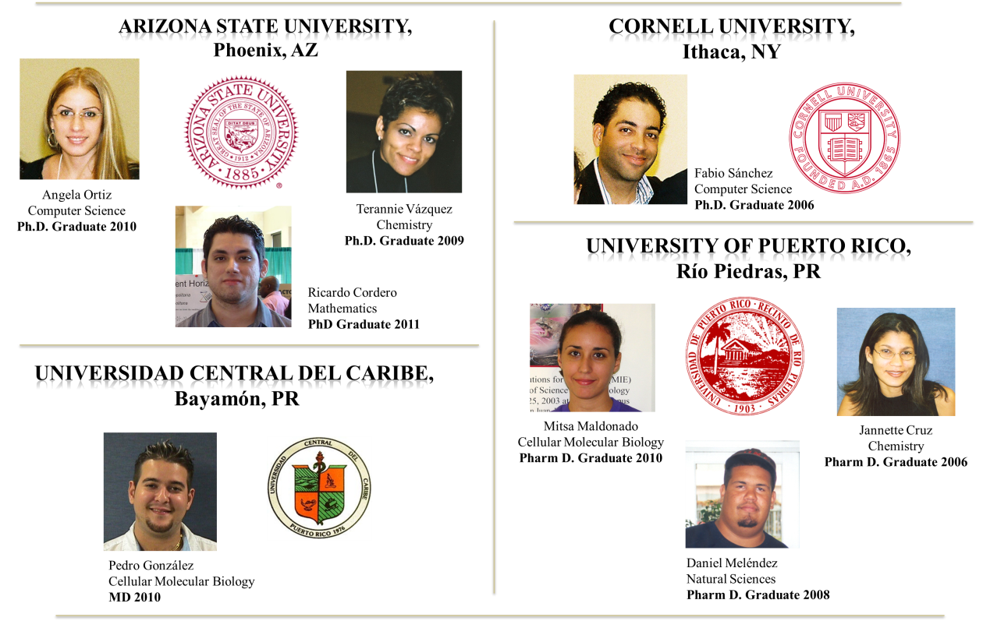
Bridge to Graduate School
Ph.D. and Doctoral Degrees

Slide 9
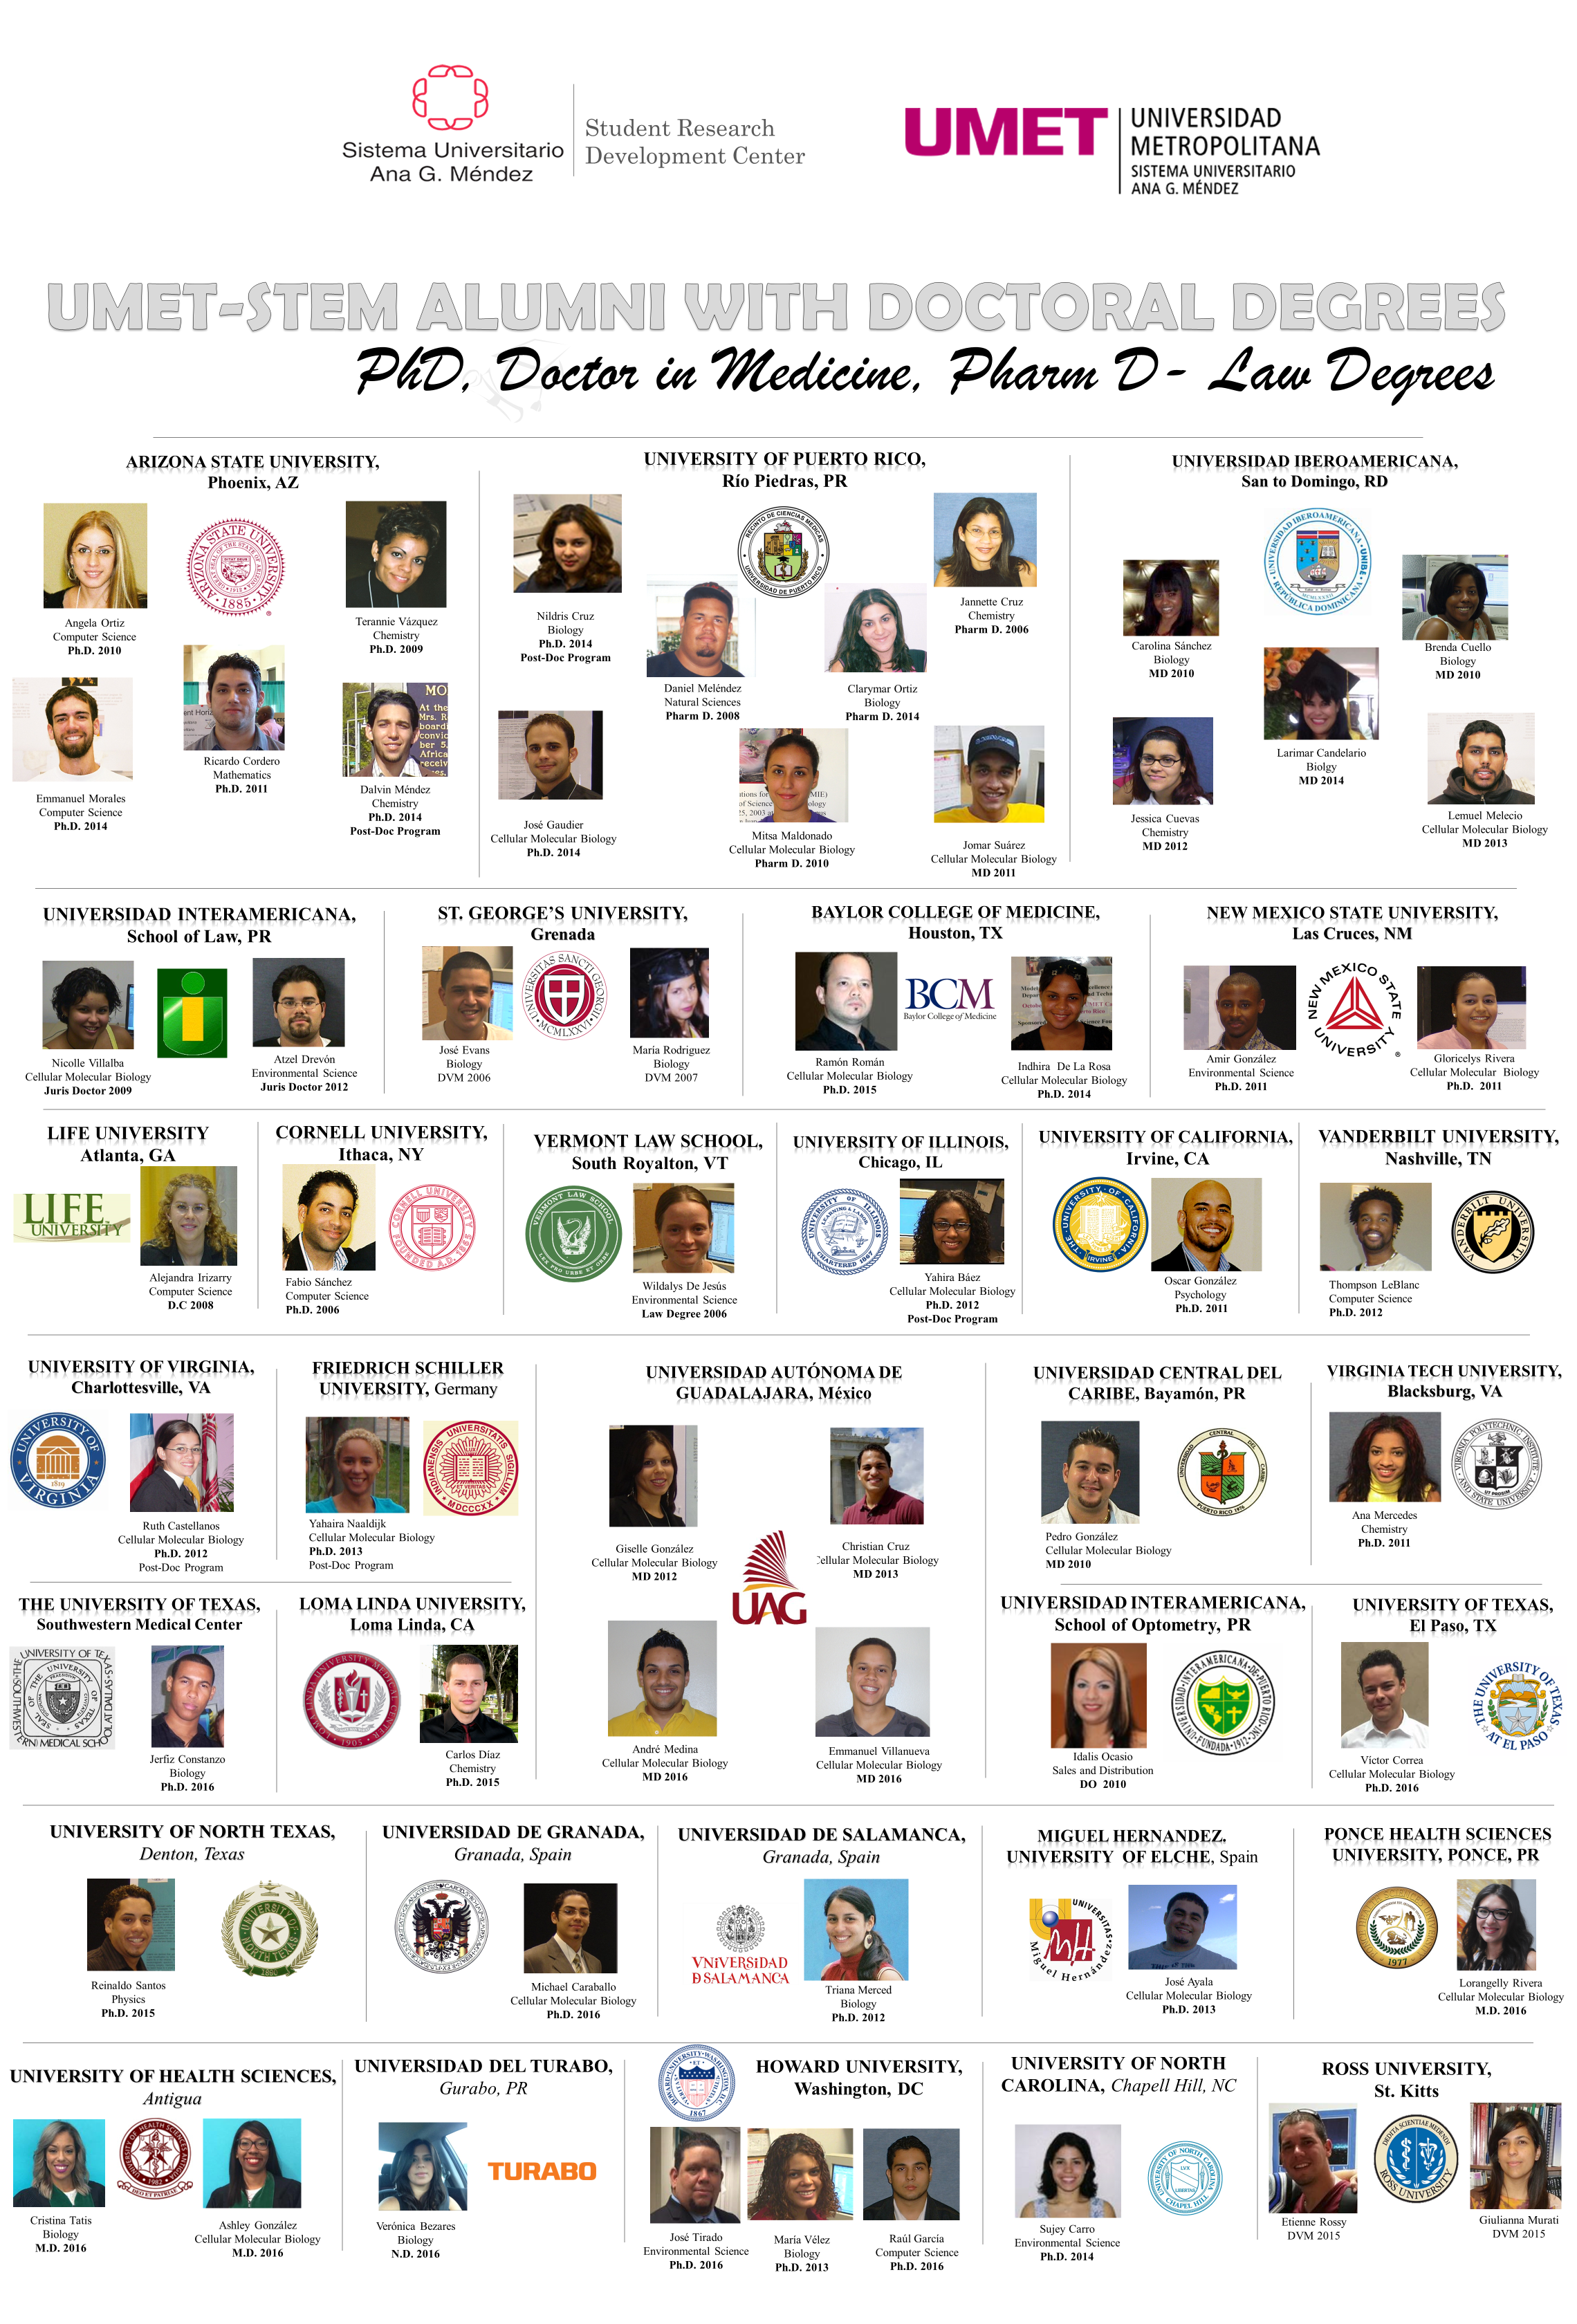

Slide 10
MIE ALUMNI WITH DOCTORAL DEGREES

Slide 11
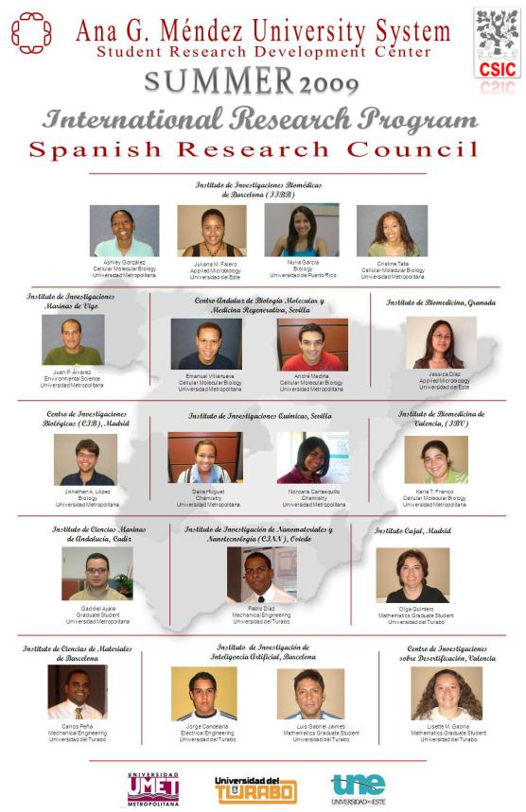
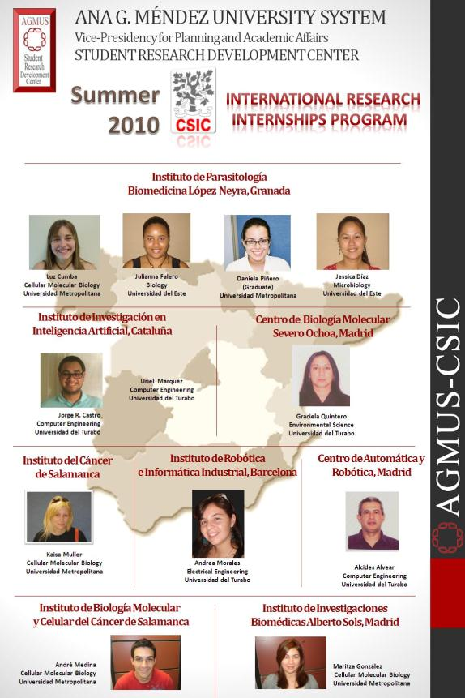
International Undergraduate Research Program (2009-2010)

Slide 12
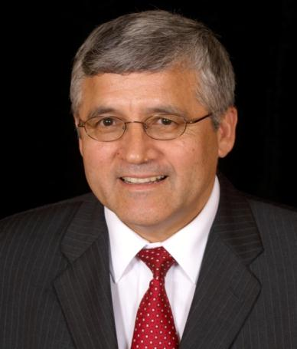
Juan F. Arratia, Ph.D
President and Founder
Scientific Caribbean Foundation, Inc.
San Juan, Puerto Rico
Former Principal Investigator (PI) of MIE, CCCE,
Puerto Rico Laser, AMISR, AGMUS Institute of
Mathematics. Arecibo Observatory REU, Co-PI
Administration of Arecibo Observatory, UNICA
Puerto Rico Alliance
Alumni of Fulbright, Organization of American State, Rotary
International, American Field Service, Universidad Tecnica del
Estado. 2006 White House Presidential (PAESMEM) Award
Recipient. Fulbright Specialist
Phone: (787) 308 5132
E-mail: juan.arratia@gmail.com
Web Page: http//www.scfpuertorico.com

